Slide 1
Biped Walking Robot
By Gone Ramu

Slide 2
Project Aim
To make a 6 DOF Biped Walking Robot using Arduino Mega.

Slide 3
Apparatus Required
Hardware Tools :
Arduino Mega
Servo Shield
6 Servo Motors
Jumper wires
Arduino & USB cable
2 Battery Source
Screws and nuts
Clamps

Slide 4
Apparatus Required
Software Tools :
Arduino IDE
Adafruit library
Arduino code of Biped Walking Robot
Biped Robot cad file

Slide 5
Procedure
Arrange 6 Servos in according to Biped Walking Robot structure along with its parts.
Integrate 6 Servos with Servo Shield.
Now connect the 6 Servos and Servo shield to Arduino mega.
Connect Batteries to Servo shield for supplying the power.
Plan the Walking Strategy for Biped Robot.
After Gait planning , Open the Arduino IDE
Upload the Biped Walking Robot Code in to Arduino mega.
Biped Walking Robot is Done.

Slide 6
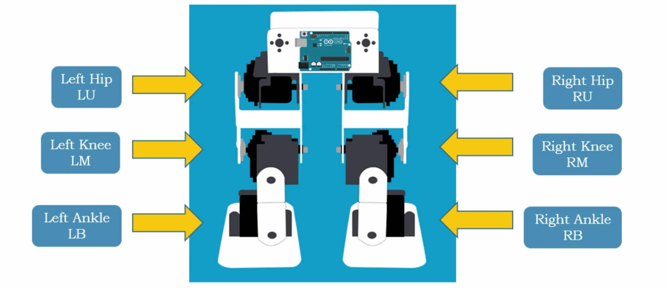
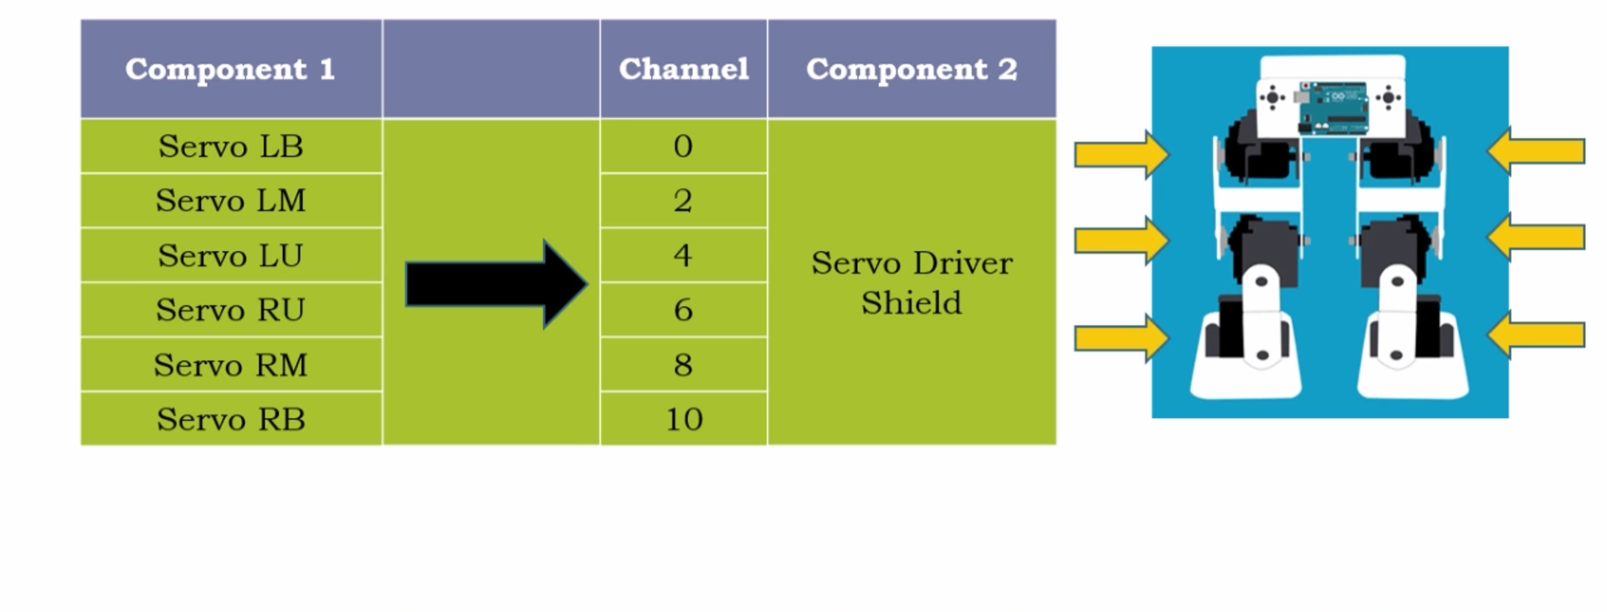
Circuit Connection
6 Servos positions in Biped Robot and Their Labels :
6 Servos connection with Servoshield

Slide 7
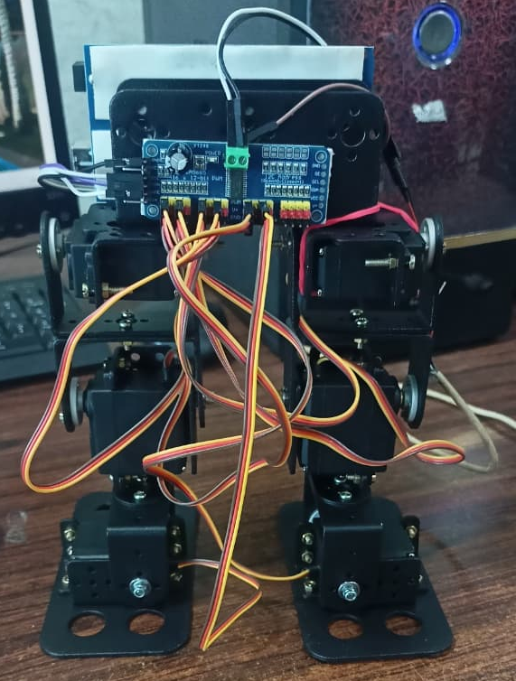
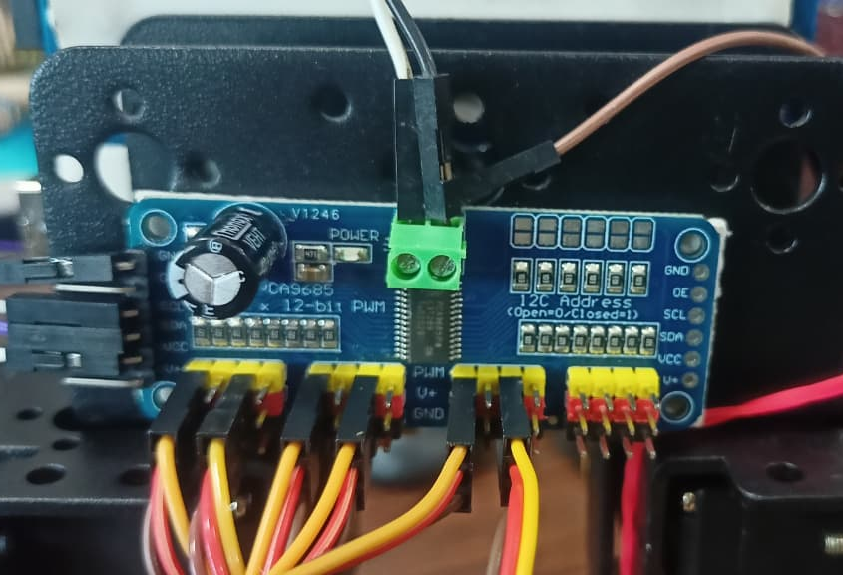
Circuit Connection
Servoshield connection with Batteries :
Servoshield | Battery
VCC | Anode
GND | Cathode/GND

Slide 8
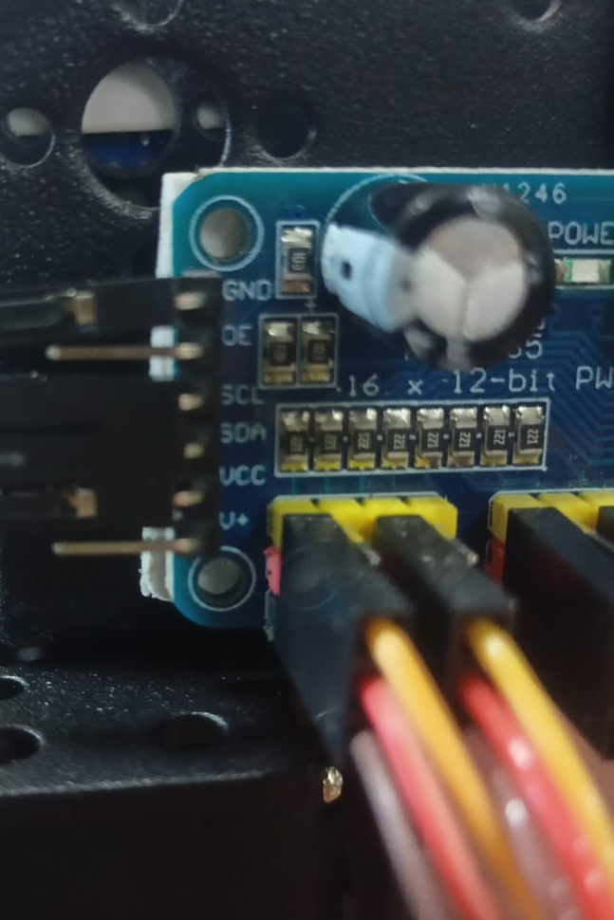
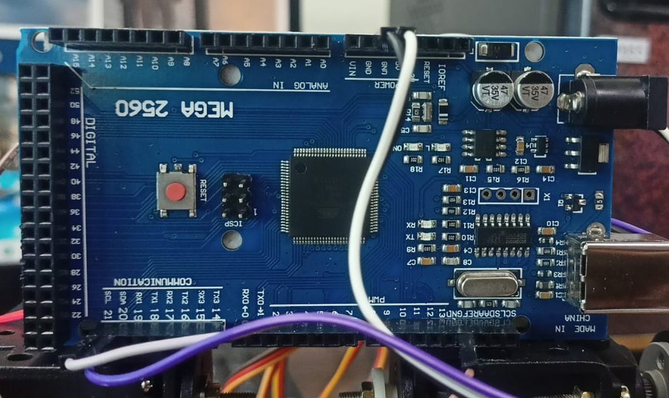
Circuit Connection
Servoshield connection with Arduino Mega :
Servoshield | Arduino mega
VCC | 5v
GND | GND
SDL | SDL
SDA | SDA

Slide 9
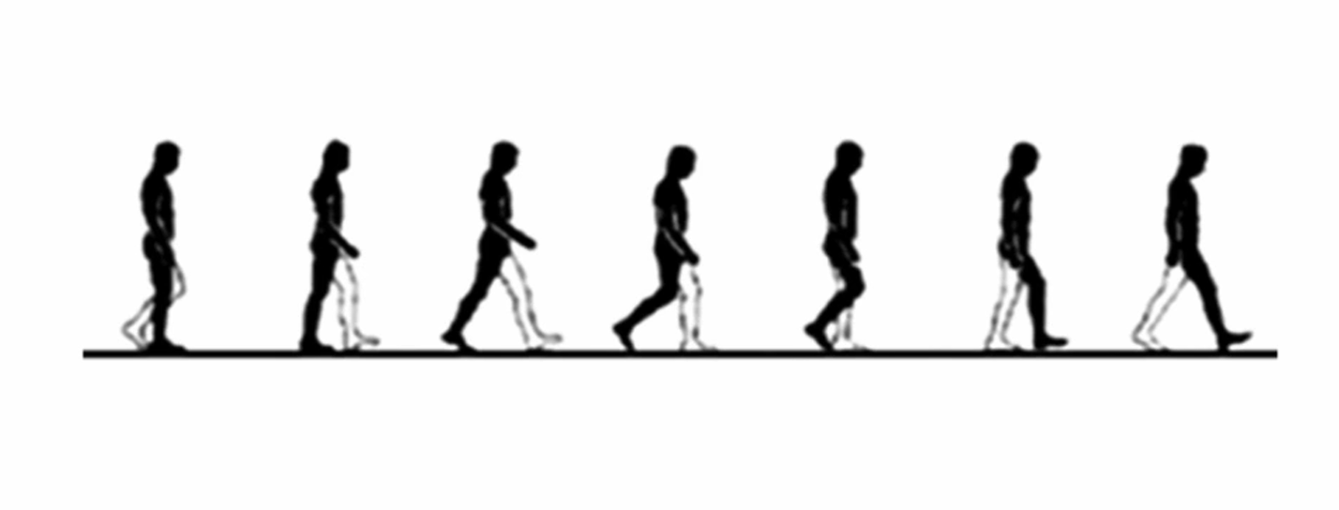
Biped Walking Gait

Slide 10
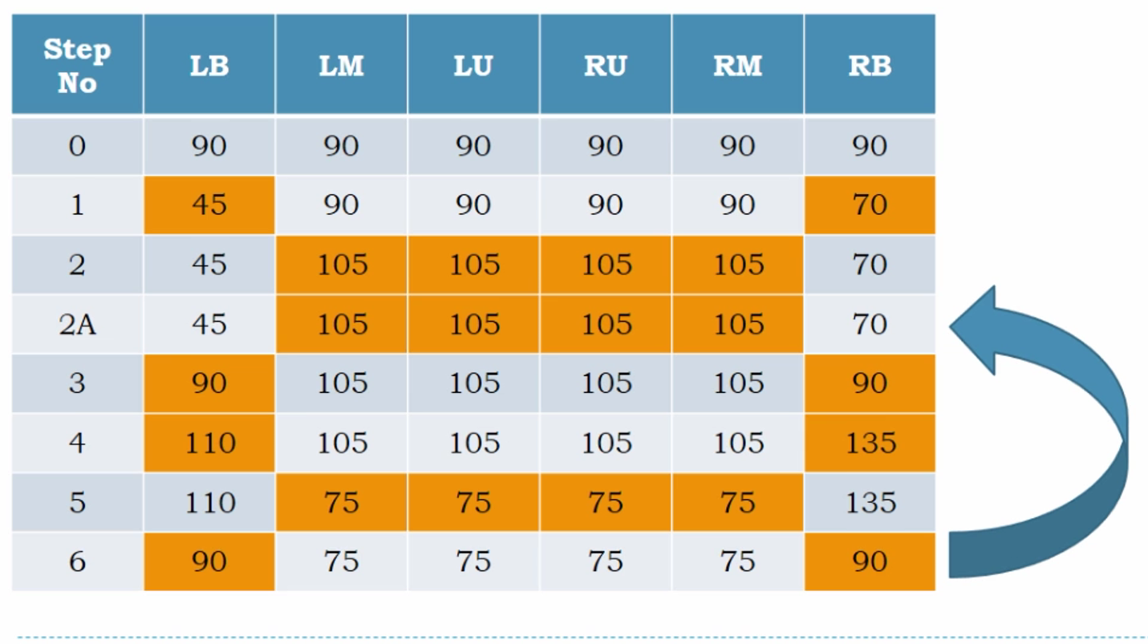
Biped Walking Strategy

Slide 11
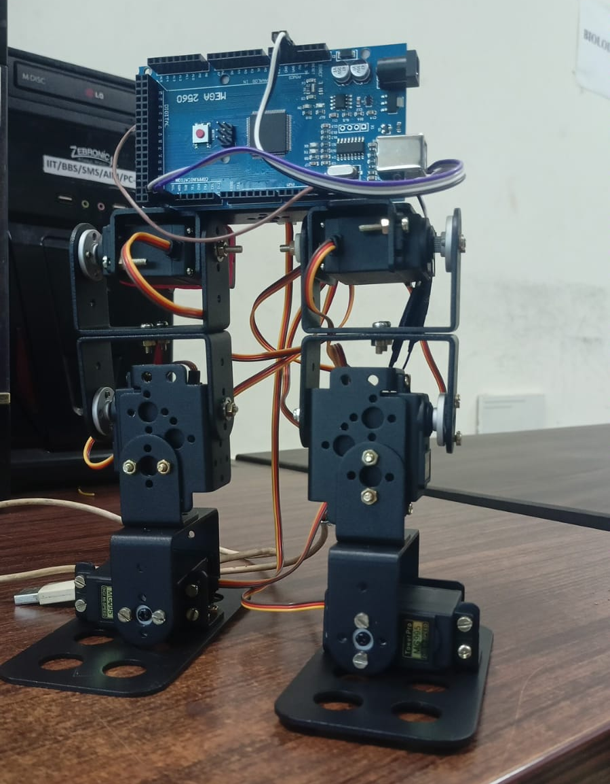
Result
Finally, we made 6 – DOF Biped Walking Robot
using Arduino Mega

